Slide 1
MOVIE THEATRE REVENUE & OPERATIONS ANALYTICS
Presented by: Bala Abineshwar B

Slide 2
Introduction
CineMax Movie Theatre Revenue & Operations Analytics focuses on analyzing multiplex booking data to understand box office performance, ticket volume, food and beverage revenue, and operational efficiency.

Slide 3
Objectives
Analyze overall box office and ticket sales performance
Identify trends in monthly revenue and seasonal patterns
Understand movie, genre, and theatre-related performance
Evaluate operational metrics such as show timings, weekday vs. weekend splits, and seat occupancy
Generate actionable insights and interactive executive dashboards to support strategic decision-making

Slide 4
Dataset
Domain: Multiplex Ticket Sales & Operations
Period: Annual Performance Cycle
Dataset Structure (9 Core Tables): Fact_Ticket_Sales, Dim_Movie, Dim_Show, Dim_Date, Dim_Theatre, Dim_Promotion, Dim_Category, Dim_Customer, Dim_Screen

Slide 5
Tools Used
Power BI Desktop
Advanced DAX Measures & Modeling (CALCULATE, TREATAS, SUMX)
Star Schema Relational Architecture
Dynamic Slicers

Slide 6
Data Preparation & Modeling
Inspected relational schema and verified primary/foreign key integrity across dimension and fact tables
Created custom calculated columns such as Day_Type (Weekday / Weekend) within Dim_Date
Checked data consistency, formatting, and numeric aggregations prior to building the command center interface

Slide 7
Movie Theatre Revenue & Operations Analytics Dashboard
Key Performance Indicators
Total Revenue: ₹6.59M
Total Tickets: 18K
F&B Revenue: ₹2M
Average Occupancy: 61.98
Average Customer Rating: 3.98 / 5

Slide 8
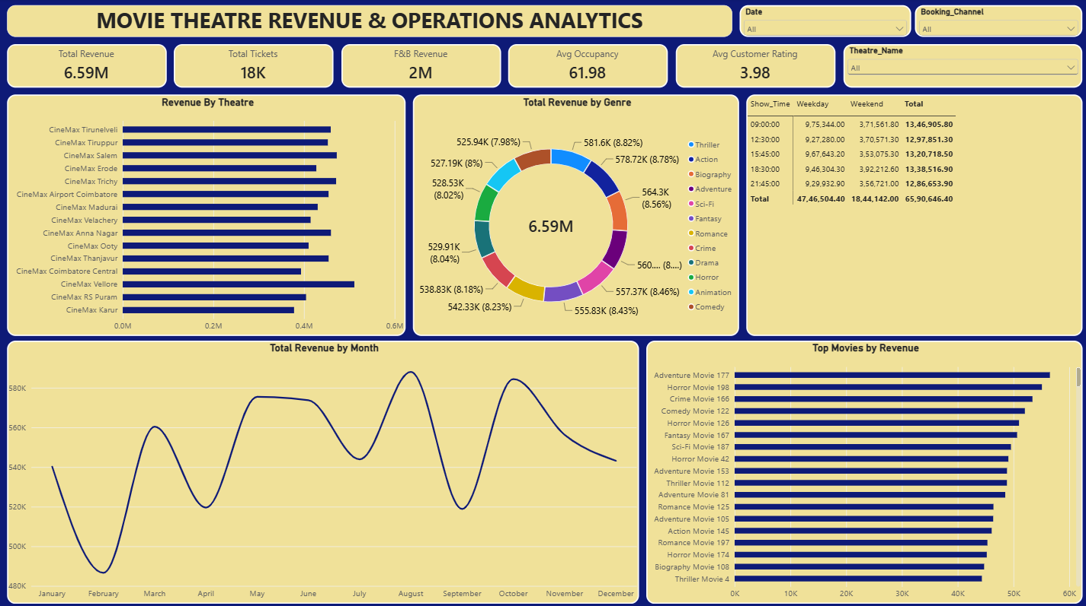
Dashboard Visual Layout & Analysis
Revenue By Theatre: Horizontal bar chart comparing earnings across key multiplex locations like Vellore, Salem, and Trichy
Total Revenue by Genre: Center Donut Chart detailing percentage splits and revenue contribution across thriller, action, comedy, and drama categories
Show Time vs. Day Type Matrix: Custom cross-tabulation table breaking down screening schedules against weekday and weekend revenue distributions
Total Revenue by Month: Annual trend line tracking revenue fluctuations across the calendar year
Top Movies by Revenue: Horizontal ranking chart displaying top-grossing movie titles
Executive Slicers: Top-header interactive dropdown filters for Date, Booking Channel, and Theatre Name enabling full page dynamic control

Slide 9
Key Insights
CineMax Vellore and Salem recorded some of the highest individual box office revenue contributions
Action and Thriller genres generated the highest percentage share of total genre revenue
Morning screening slots capture substantial box office and ticket sales volume, making them a crucial contributor to total earnings alongside evening slots
Weekday and weekend revenues show distinct patterns across morning and evening screening hours
Food and beverage sales achieved a strong ₹2M revenue contribution, significantly boosting total location profitability
Seasonal trends indicate distinct peaks in audience attendance during specific monthly cycles

Slide 10
Business Observations
Audience demand is distributed across both morning and evening hours, requiring balanced scheduling across all time blocks
High visitor volume during prime screening slots places additional operational pressure on multiplex resources
Food and beverage cross-selling acts as a vital revenue pillar that requires continuous monitoring
Promotional discount campaigns successfully lift ticket sales volume during non-peak hours, though net margin tradeoffs must be balanced
Variations in seat occupancy across different show timings point to opportunities for schedule optimization

Slide 11
Recommendations
1. Maximize Morning & Peak Show Potential: Align screen allocations to capitalize on strong morning screening demand while balancing prime evening slots.
2. Boost Weekday Utilization: Introduce specialized movie-and-snack bundle promotions during lower-traffic windows to increase seat occupancy.
3. Enhance F&B Cross-Selling: Leverage popular food and beverage combos at the point of sale during high-volume morning and evening rushes to maximize customer spending per transaction.
4. Target Off-Peak Promotions: Deploy data-driven promotional offers during slower slots to smooth out attendance curves across the week.
5. Monitor Theatre Performance: Continue tracking revenue, ticket volume, and seat occupancy by location regularly to guide staffing and operational decisions.

Slide 12
Conclusion
The Power BI analysis provided a comprehensive view of box office activity, F&B revenue, customer patterns, and operational efficiency at CineMax.
The executive command center dashboard successfully unifies financial reporting and operational metrics into a single interface, empowering leadership to identify areas requiring attention and support data-driven decision-making.

Slide 13
Key Learnings
Improved advanced Power BI data modeling and star schema relationship management skills
Practiced building responsive, executive-grade single-page command center layouts
Learned how to convert raw entertainment data and complex relational structures into actionable business recommendations

Slide 14
Thank You
Questions & Answers

